Slide 1
Panoramic Image Stitching
Feature-Based Registration and Blending
Digital Image Processing Project
Mohanad Elbehairy • Ahmed Hany • Eyad Ahmed

Slide 2
Problem & Objectives
The Challenge
Combine multiple overlapping photos into one wide panorama
Align images with sub-pixel accuracy
Handle real-world variations (lighting, distortion, parallax)
Key Objectives
Robust feature detection and matching
Reliable geometric alignment with failure recovery
Seamless blending across overlaps

Slide 3
Real-World Applications
Photography
Landscape & architectural panoramas
Imaging
Medical, industrial & satellite mosaics
Virtual Tours
360° immersive environments

Slide 4
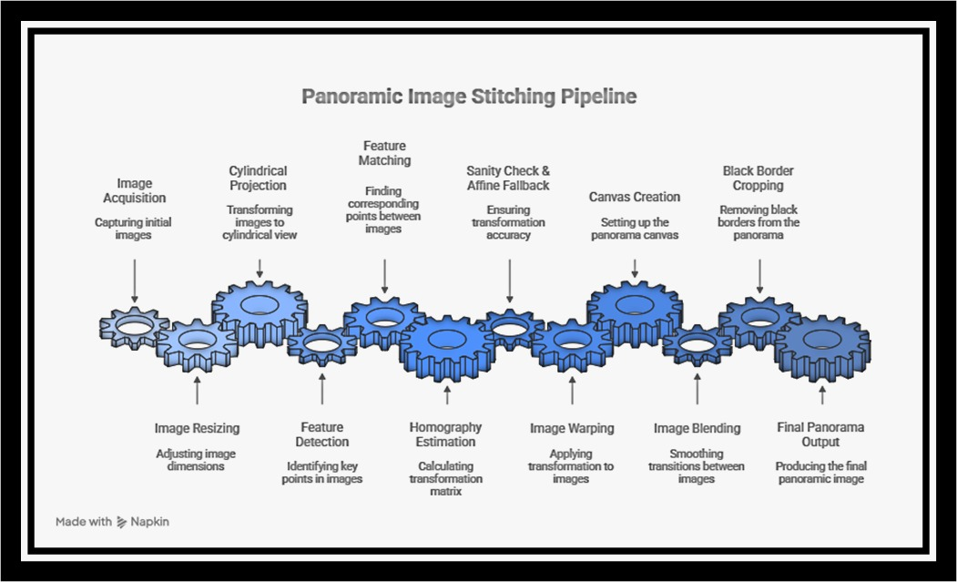
Complete Processing Pipeline

Slide 5
Feature Detection & Matching
Feature Detectors
SIFT: Scale/rotation invariant, robust but slower
ORB: Fast binary descriptors, lightweight
Matching Strategy
KNN matching (k=2) + Lowe's ratio test (r ≈ 0.7-0.8)
Mutual (bidirectional) consistency checks

Slide 6
Homography & Robust Estimation
Homography: 3×3 projective transformation mapping image points
When It Works
Camera rotation around optical center (panorama capture)
Approximately planar scenes
Small parallax (camera far from scene)
Robust Estimation
RANSAC/USAC: Iteratively sample minimal sets, estimate H, count inliers

Slide 7
Cylindrical Projection
Reduces wide-angle distortion when camera rotates around optical center
Transformation
Normalize pixel coordinates by focal length f
Map to cylinder: xc = tan(x), yc = y·cos(x)
Project back to pixels
Parameter f: Larger f = weaker distortion; smaller f = stronger correction

Slide 8
Blending & Seam Reduction
Direct pasting creates visible seams. Solution: feather blending
Feather Blending Formula
I(x,y) = α(x,y)·I₂(x,y) + (1−α(x,y))·I₁(x,y)
α derived using distance transform for smooth weight transitions

Slide 9
Challenges & Solutions
Homography Sanity Checks
Reject extreme perspective (|H₃₁| or |H₃₂| too large)
Prevent oversized canvas allocations
Avoid black wedge artifacts
Affine Fallback
When homography fails, use partial affine (rotation + scale + translation)

Slide 10
Multi-Image Stitching Modes
Sequential Mode
Stitch left-to-right: (((I₁ ⊕ I₂) ⊕ I₃)...)
Simple but may accumulate drift
Center-Reference Mode
Anchor at middle, stitch outward
Distributes errors, reduces drift

Slide 11
Implementation Pipeline
Resize: Speed + memory control
Cylindrical Warp: Wide-angle correction
Detect & Describe: SIFT/ORB feature extraction
Mutual Ratio Matches: Robust matching pipeline
Find Homography: RANSAC/USAC estimation
Warp & Compose: Canvas alignment
Feather Blend: Seam reduction
Crop Borders: Remove black regions

Slide 12
Success Factors
SIFT: more reliable on weak texture/blur scenes
ORB: faster performance on clear corner/texture images
Cylindrical projection: reduces wedge artifacts in wide panoramas
Canvas caps: prevent memory overflow from oversized transforms
Center-reference stitching: minimizes drift with many images

Slide 13
Robustness & Failure Modes
Common Failure Causes
Insufficient overlap between images
Strong parallax (near objects + camera translation)
Severe blur or repeated textures
Extreme lighting differences

Slide 14
Evaluation Criteria
Success Metrics
Visual alignment quality in overlap regions
Clean seam with minimal visible artifacts
No memory overflow or crashes
High inlier ratio from feature matching
Output Quality
Produces coherent panoramas with automatic black border removal

Slide 15
Future Enhancements
Multiband blending for improved color consistency
Automatic exposure compensation across images
Global optimization (bundle adjustment) to reduce drift
Real-time GPU acceleration for large image sets
Machine learning-based seam detection

Slide 16
Summary
A complete feature-based panorama stitching system combining robust feature detection, intelligent matching, and practical robustness mechanisms
Delivering high-quality panoramas with diagnostic tools for success and failure interpretation

Slide 17
Thank You!
Questions?
Digital Image Processing Project • Panoramic Stitching

